Slide 1

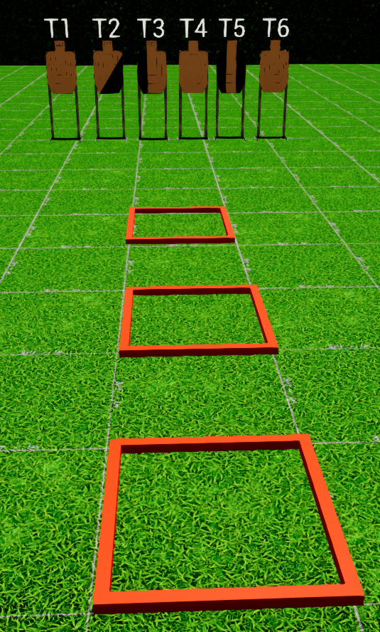
 | Interlake Sporting Association North Pistol, A Stage: North Pistol, B – One Shot One Kill Course Designer: Peter Jarvis, by modified Marcel Englmaier
START POSITION: String 1: Standing in P1 Handgun: Loaded and holstered, wrists below belt. PCC: Stock on belt, muzzle pointed downrange. String 2: Standing in P2 Handgun: Loaded and holstered, wrists below belt. PCC: Stock on belt, muzzle pointed downrange. |  | STRINGS: 2 SCORING: Unlimited ROUND COUNT: 18 START-STOP: Audible - Last shot Scoring notes: The heads and bodies of each target are scored independently. Example: T1: 1K(head), 2A(body) = All Good T2: 1A(head), 2A(body) = 1 FTN T3: 1A(head), 1A&1C(body) = 2 FTN T4: 2A(head), 3C(body) = All Good
STAGE PROCEDURE: String 1: At the start signal, engage the Heads of T1-T3 freestyle from P1, then perform a mandatory reload and engage to Bodies of T1-T3 Strong Hand Only from P2. String 2: At the start signal, engage the Heads of T4-T6 freestyle from P2, then perform a mandatory reload and engage to Bodies of T4-T6 Weak Hand Only from P3.
P3
P2
P1

